Slide 1
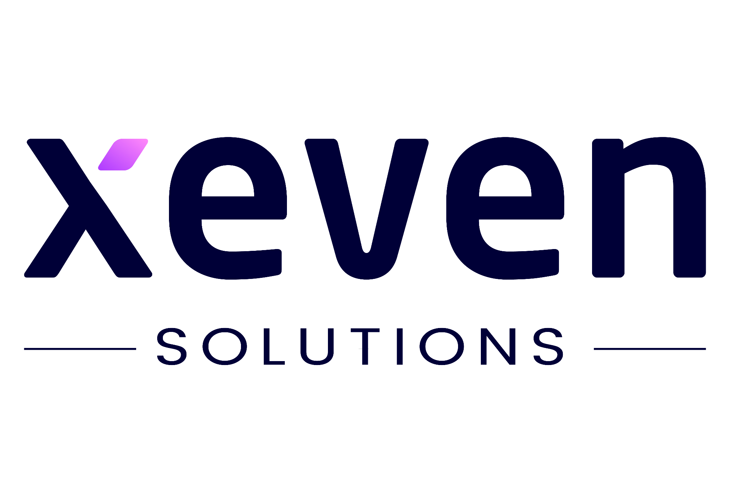

Lecture 03
Irfan Malik
Dr. Sheraz Naseer

Slide 2
Agenda
Recap
Deep Learning
Neural Networks
Generative AI
Discriminative vs Generative AI

Slide 3
Previous lecture:
Lecture 02 - Machine Learning Essentials
Click Here

Slide 4
Recap

Slide 5
Artificial Intelligence
Machine Learning
Deep Learning
Artificial Intelligence is the branch of computer science concerned with development of methods that allow computers to learn without explicit programming.
Machine Learning is a branch of AI, which focuses on methods, that can learn from examples and experience instead of relying on hard-coded rules and make predictions on new data.
Subfield of Machine Learning that focuses on Neural Networks (Inspired from Biological neurons) to develop learning models.

Slide 6
Relationship in AI, ML and DL
Machine Learning:
SVM, Tree Algorithms, Nearest neighbors, bagging, boosting, Deep Learning
Artificial Intelligence:
Search Algorithms, Rule Based Systems, Statistical Inference, Machine Learning
Deep Learning:
FCNs, CNNs, RNNs, Transformers, Autoencoders, GANs

Slide 7
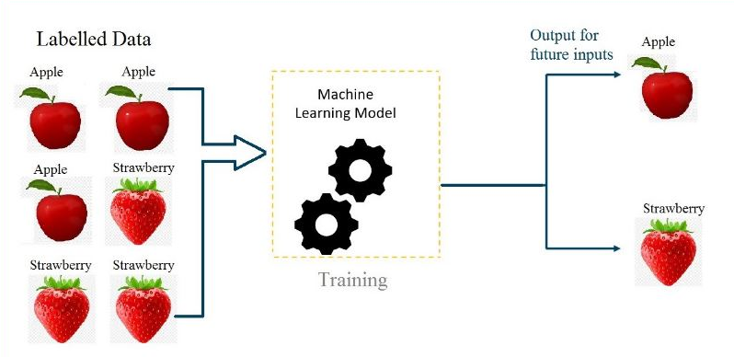
Supervised learning:
Supervised learning is a category of machine learning that uses labeled datasets to train algorithms to predict outcomes and recognize patterns.

Slide 8
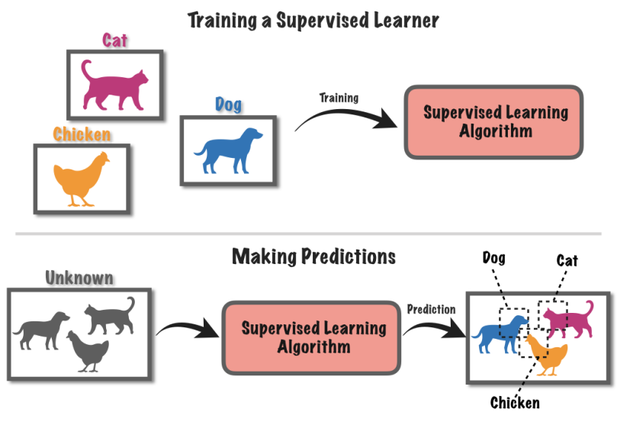

Slide 9
Some supervised algorithms:
k-Nearest Neighbors
Support Vector Machines (SVMs)
Linear Regression
Logistic Regression
Decision Trees
Random Forests

Slide 10
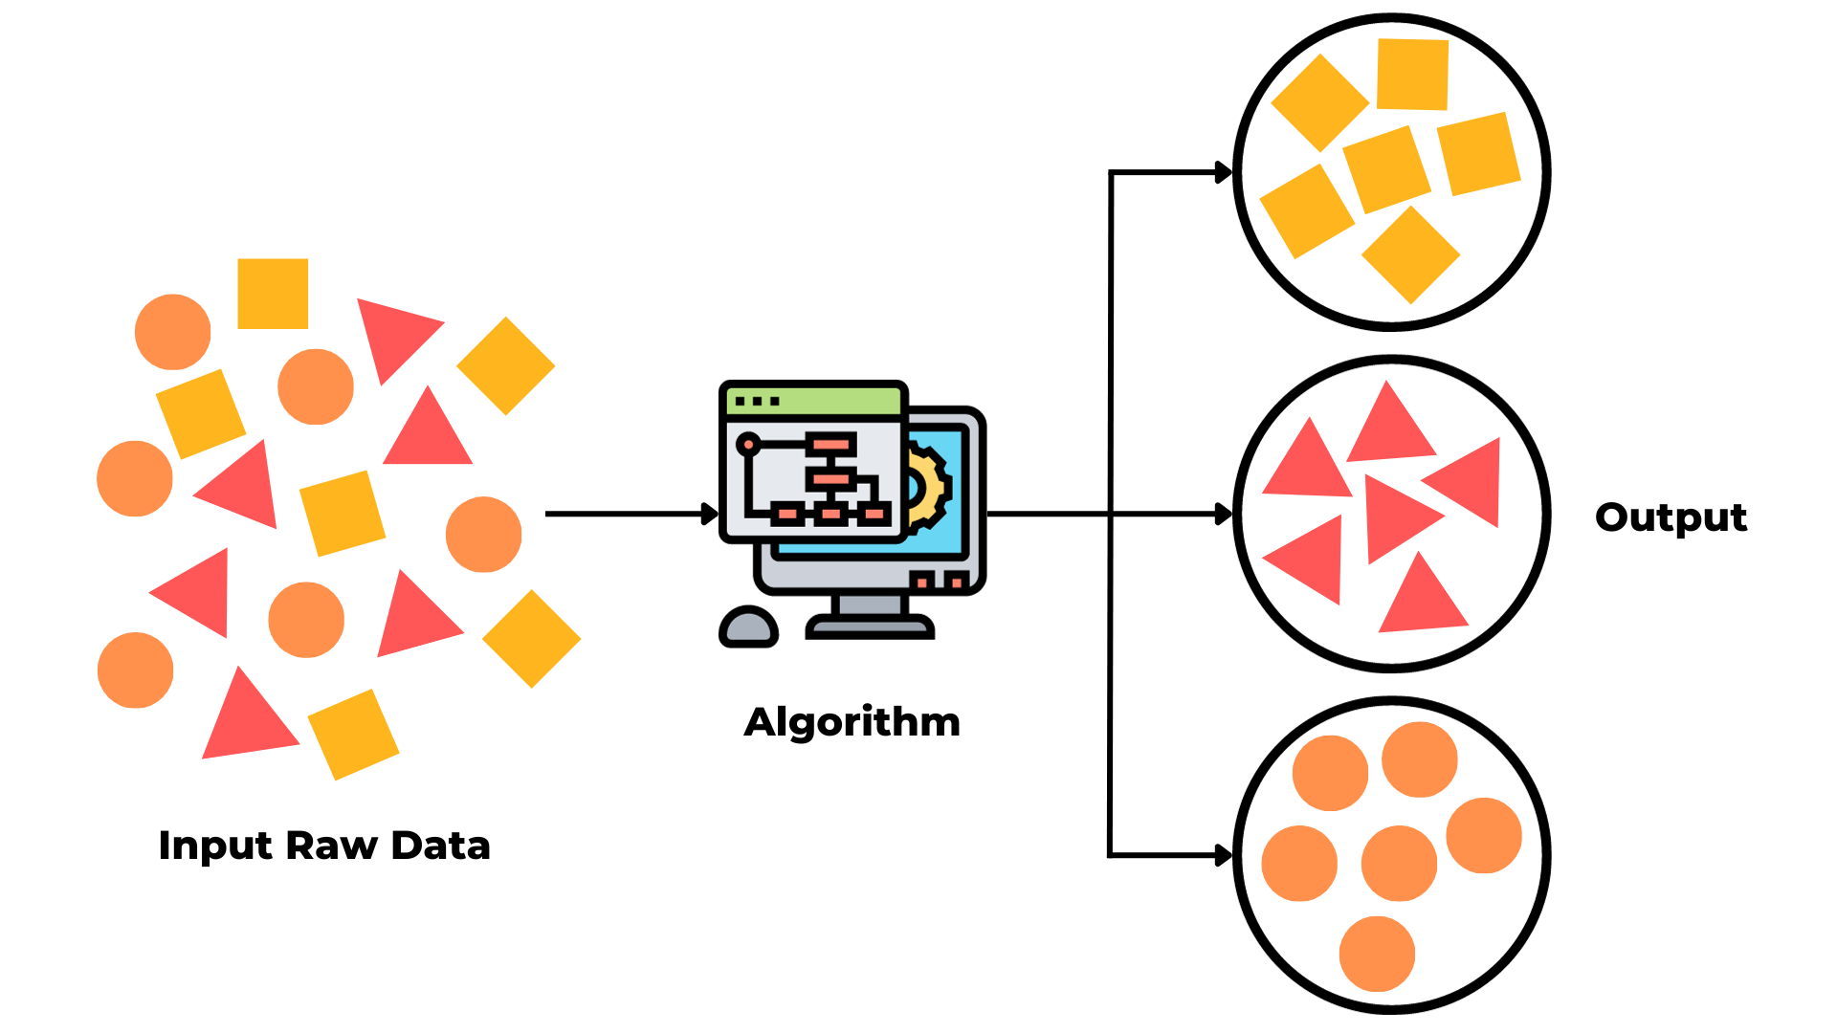
Unsupervised learning:
Unsupervised learning is a type of machine learning algorithm where the model learns from unlabeled data, meaning there are no predefined target labels.

Slide 11
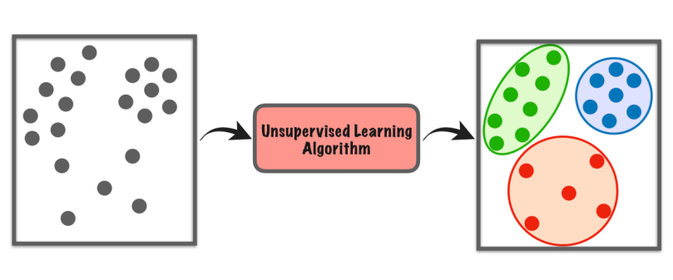
Unsupervised learning
Clustering
Dimensionality Reduction
Anomaly Detection

Slide 12
Some Unsupervised learning algorithms
K-Means
DBSCAN
Hierarchical Cluster Analysis(HCA)
One-class SVM
Principal Component Analysis(PCA)
t-distributed Stochastic Neighbor Embedding(t-SNE)

Slide 13
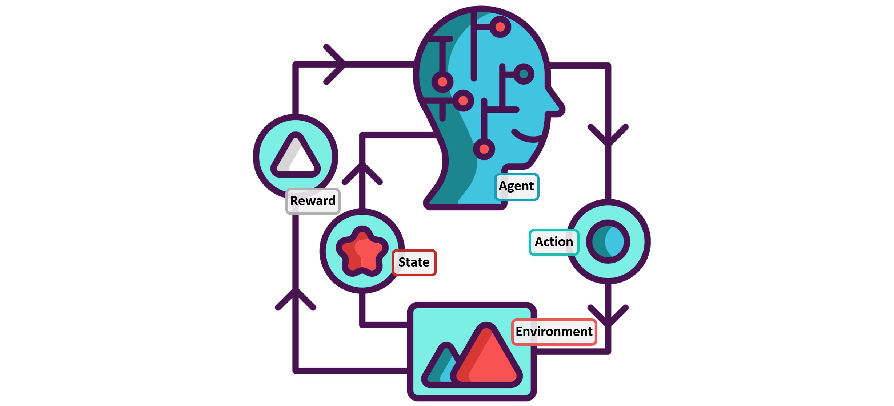
Reinforcement learning:
Reinforcement learning is a type of machine learning algorithm where an agent learns to make decisions by interacting with an environment. The agent receives feedback in the form of rewards or penalties based on its actions, and its goal is to learn the optimal strategy to maximize cumulative rewards over time.

Slide 14
Some Reinforcement Learning algorithms
Q-Learning
SARSA
Deep-Q network(DQN)
Policy gradient methods
actor-critic methods
Markov Decision Process

Slide 15
Deep Learning

Slide 16
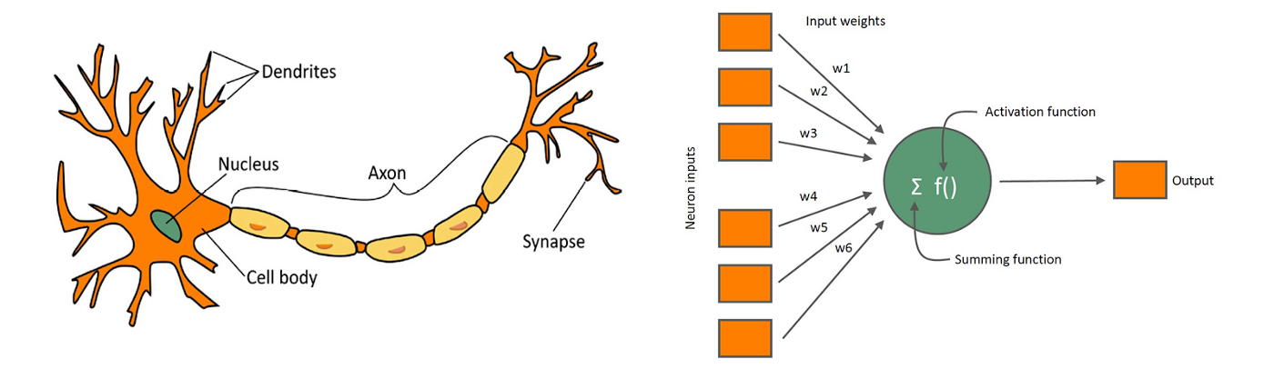
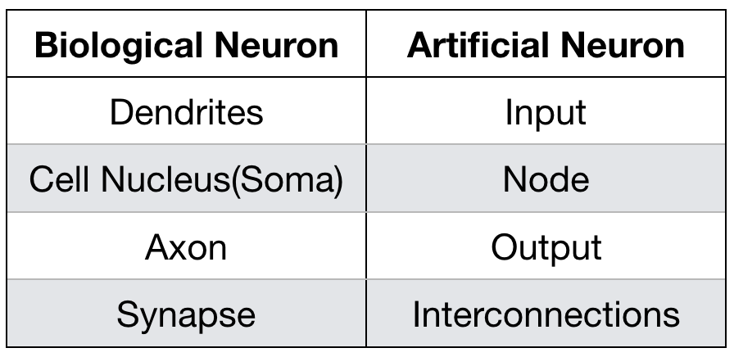
Biological Neuron
Artificial Neuron

Slide 17
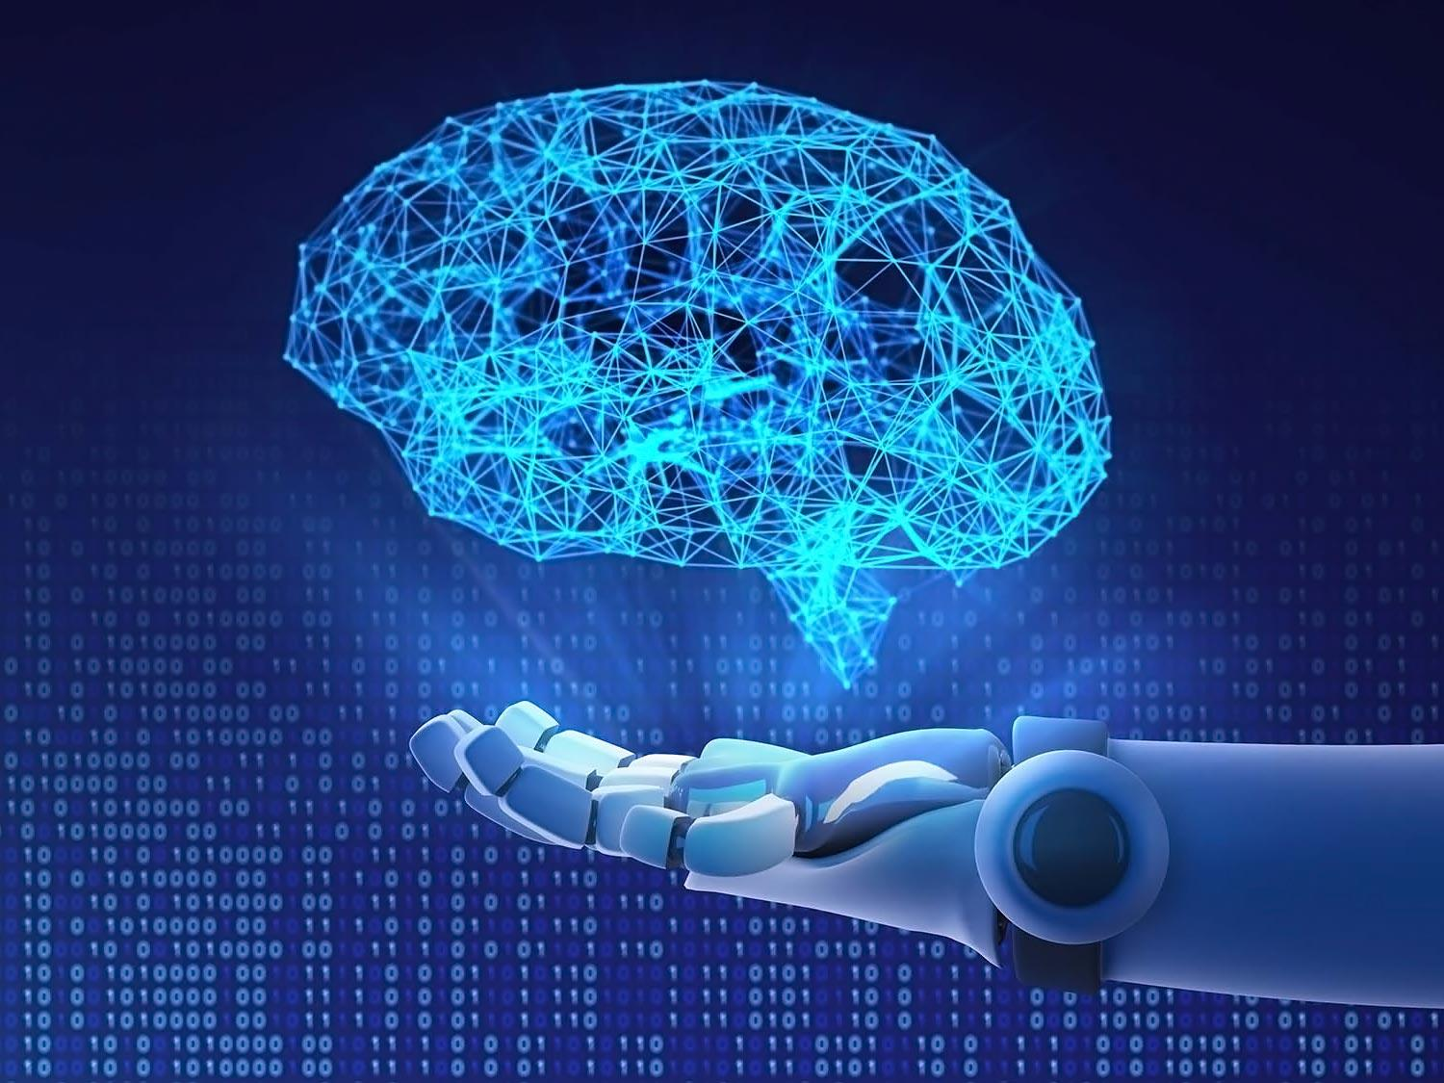
Neural Networks
Neural Network, also known as Artificial Neural Networks(ANNs) or Simulated Neural Networks(SNNs),is an interconnected group of nodes inspired by a simplification of neurons in brain.

Slide 18
Neural Network

Slide 19
ML vs. DL

Slide 20
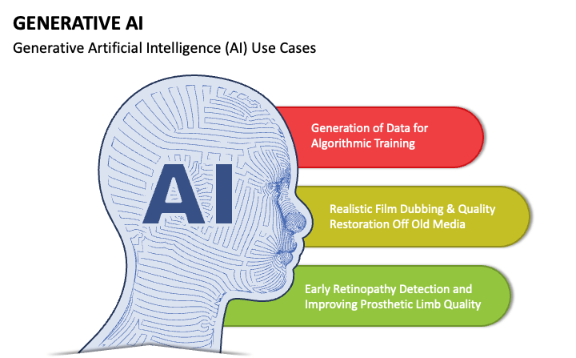
Generative AI
Generative AI, also known as GenAI is a type of artificial intelligence that creates new content based on the patterns learned from existing data .These algorithms can generate text, images, videos, audio, code etc.

Slide 21
Generative AI
Text Generation
ChatGPT 3.5/4
Bard
Image generation
Dall-E3
Stable Diffusion
Music Generation
Music-LM
Video Generation
Runway ML Gen-2

Slide 22
Discriminative vs Generative AI
Discriminative Al represents a specialized area in artificial intelligence focused on distinguishing between different types of data input . Unlike Generative AI, Discriminative AI relies on existing data, identifying and categorizing it based on the learned patterns.
Generative Artificial Intelligence , also known as GAI refers to AI system capable of generating , text, images or other data in response to inputted prompt. These system learn from existing data and then create new content that shares similar characteristics with training data.

Slide 23
Summary
Deep Learning
Neural Networks
Generative AI
Discriminative vs Generative AI

Slide 24
Next Lecture:
Lecture 04 - Deep Dive into Generative AI
Click Here

